Slide 1


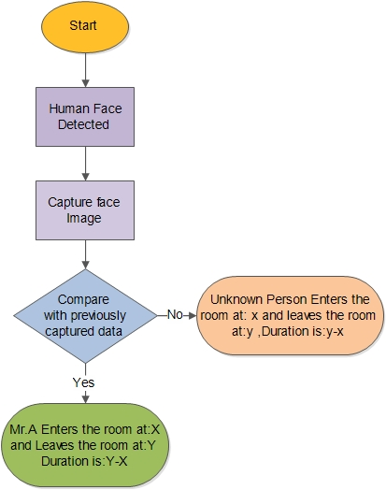
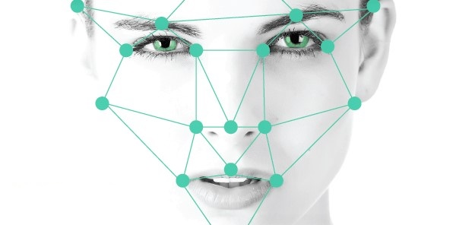
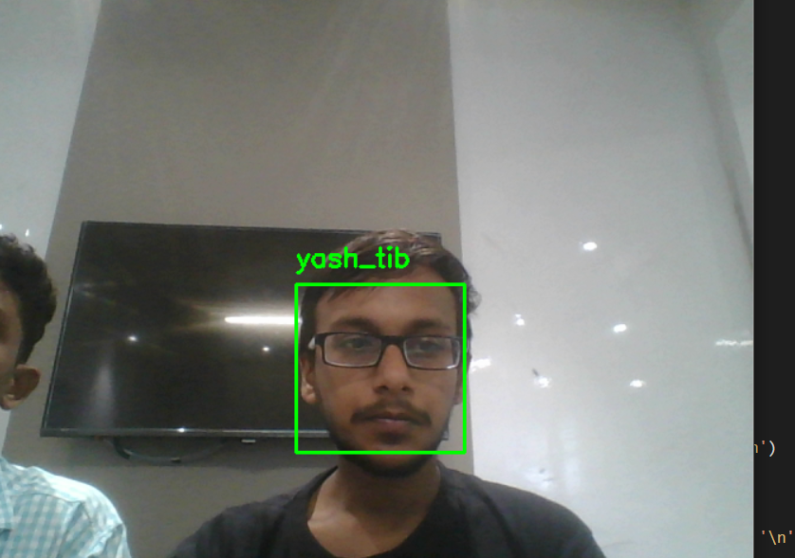
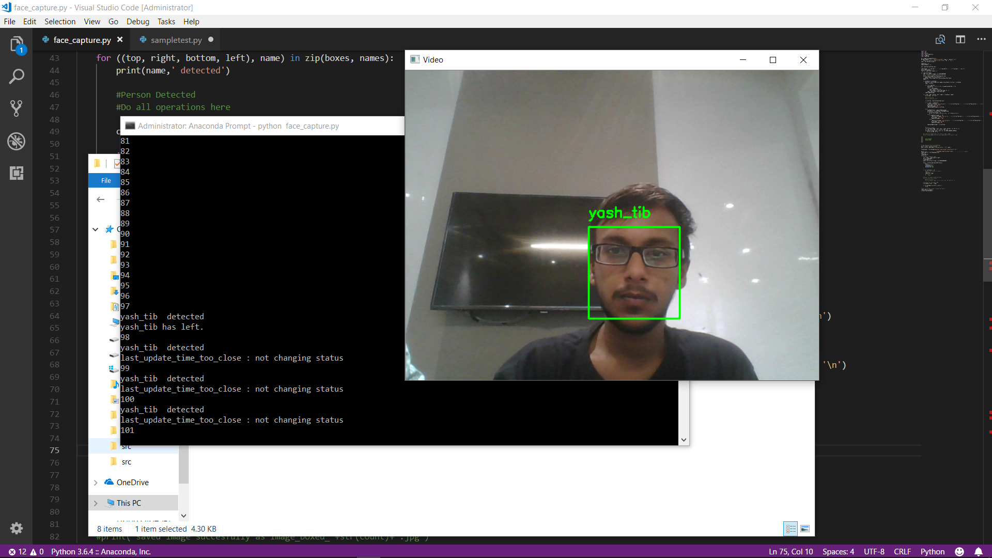

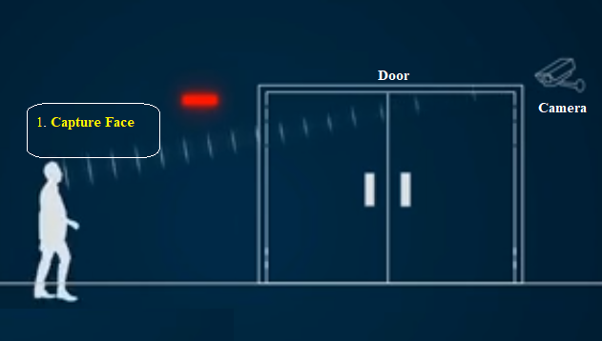
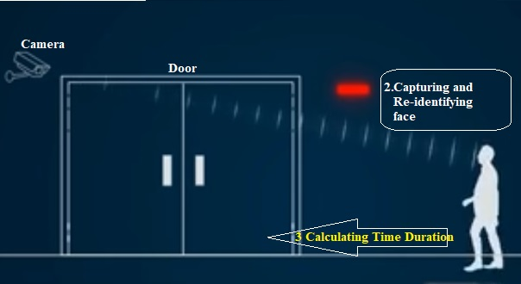

Real Time Face Recognition And Tracking
Yash Tibarewala , Jithu Divakaran
Mentor: Mr. Tejalal Choudhary
Abstract
The processes involved in this Face Recognition and Tracking can be represented in the form of a flow chart as follows:
The face is one of the easiest ways to distinguish the individual identity of each other. The rapid advancements in the field of computer vision, which is backed by the powerful Deep Learning algorithms made it easy to Recognize and Identify a person based his unique facial Characteristics. In a real streaming environment this concept has great importance.
This project aims at automatically calculating the time duration that a person spend in a room through recognition and re-identification of person’s face in a completely automated manner by using dedicated cameras fixed in the room entrances and exits. Tracking of visitors in manually is time consuming and difficult task. It requires more human intervention and time. But this project offers a complete and accurate automatic visitor tracking mechanism through deep learning. This project can mainly consider as a way of security measure. But its scope can be extended to several other areas too.
Introduction
Today automation is available in all fields. Here we are using a Real Time automated system for tracking the visitors of a room.
The manual process of recording and calculating the entry and exit time, tracking the visitors of a room has many limitations like limited accuracy, time consumption, resource requirements etc..
The Real Time Face Recognition System is very efficient in identifying a person based on his unique facial characteristics. This can be utilized to calculate the time that a person spends in a room.
This real time system will automatically monitors the presence of individuals, and automatically mark their entry and exit time, so that the duration of time they have spend in a room can be easily and automatically calculated. This will increase the accuracy in computation and reduces the human effort in the processes.
1
2
Entry Time Exit Time
3
Proposed Method
The idea is to deploy this model using a normal surveillance camera fixed on the room entrances to capture the visitors faces and to calculate the time that they spend on the room. The basic idea behind this project is Computer vision and the Convolutional Neural Networks (CNN).The working of the proposed system can be illustrated as follows:
Output Log File
Phase 1
Phase 2
Conclusions
Face recognition can be applied in Security measure at Banks , Offices ,Homes etc. Face recognition has received substantial attention from researches in biometrics, pattern recognition field and computer vision communities. Here Face Recognition along with real time Tracking offers wide range of applications like Automated Attendance System, Automated Billing based on time of consumption, Automated Visitor Tracking, Tracking unauthorized persons etc..
Limitations:
Image quality affects how well facial-recognition algorithms work. The image quality of scanning video is quite low compared with that of a digital camera
The relative angle of the target’s face influences the recognition score profoundly.
Future Enhancements:
By the application of similar Real Time Face recognition and Tracking system in future the case of anonymity can be avoided. Nobody can remain as an anonymous person, every body will be monitored and traceable.
fig:1.1 fig:1.2
Here in Phase 1 (fig:1.1) the camera captures the visitor’s face and labels it with respective timestamp. Then in Phase 2 (fig:1.2) the face captured will be compared with the stored faces and calculate the Time duration using the labels of matching faces.
Experimental Results and Discussion
We have used multiple images of same person for training the model. Where images of same person are stored independently in separate directories. We used images of 20 persons to train the model. Each directories consist of 25 images of the same person.
References
https://disruptionhub.com/5-applications-facial-recognition-technology/
https://money.cnn.com/2012/01/13/technology/face_recognition/
Team No. - 19

